Slide 1

Introduction to Management – 1 & 2

Slide 2
Business Organization
A business organization is a, group of people working together to satisfy human needs and wants by producing goods and services with a common objective of profit maximization.
List goals of a business organization.
1. Financial goals
2. Growth goals
3. Customer goals
4. Employee development goals
5. Social goals

Slide 3



Productive Resources
Operating cost
Land
Entrepreneurship
Labor
Capital
OC: Cost of acquiring and using the four productive resources

Slide 4
Business Functions; buy, make, sell, trade
Buy/acquire
Make/Process
Sell or Trade
Labor
Material
Capital
Technology
Equipment and machineries
Knowledge and information etc
Warehouse
Production and operations
Marketing
Financing and accounting
Human resource management etc
Research and development (R&D)
Selling and distribution
Exchange, trade of goods and services

Slide 5
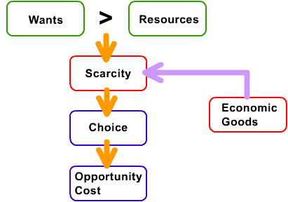
What is the basic economic problem ?

Slide 6

Scarcity
A limited amount of resources to meet an unlimited amount of wants and needs.
Everything is scarce..!

Slide 7
Why do we have scarcity?
We have unlimited wants and needs but limited resources create scarcity.
So we need to make choices
What to produce
How to produce
For whom to produce.

Slide 8
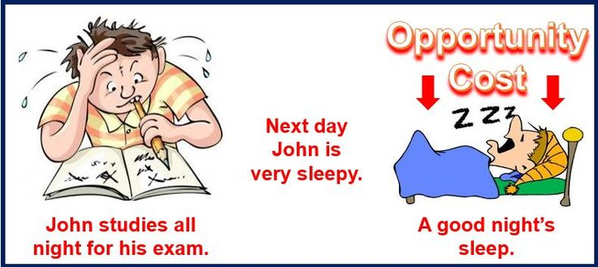
Opportunity Cost
The best alternative
sacrificed to a chosen alternative

Slide 9

Why study management?
Universality of management
The reality of work
The rewards and challenges of being a manager

Slide 10

What Is Management?
  The art of getting things done through people.
  The process of,
  Planning, Organizing, Leading and Controlling the work of the organization members and using all available organizational resources to reach stated organizational goals, efficiently and effectively in an ever changing business environment.
  Coordinating work activities so that they are completed efficiently and effectively with and through other people (Robbins & Coulter, 2005).

Slide 11
The Process of Management
0
Planning
Select goals and ways to attain them
Resources
Performance
Human
Financial
Raw Materials
Technological
Information
Attain goals
Products
Services
Efficiency
Effectiveness
Controlling
Organizing
Monitor activities and make corrections
Assign responsibility for task accomplishment
Leading
Use influence to motivate employees

Slide 12

Who Are Managers?
    Someone who coordinates and oversees the
    work of other people so that organizational
    goals can be accomplished.

Slide 13
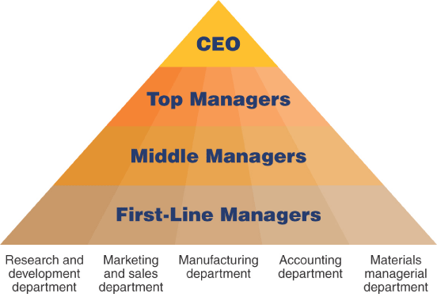
Types of Managers/ Levels of Management

Slide 14
TOP MANAGEMENT LEVEL
It consists of board of directors, chief executive or managing director. The top management is the ultimate source of authority and it manages goals and policies for an enterprise. It devotes more time on planning and coordinating functions.
Top management lays down the objectives and broad policies of the enterprise.
It issues necessary instructions for the preparation of department budgets, procedures, schedules etc.
It prepares strategic plans & policies for the enterprise.
It appoints the executive for the middle level i.e. departmental managers.
It controls & coordinates the activities of all the departments.
It is also responsible for maintaining contact with the outside world.
It provides guidance and direction.

Slide 15
MIDDLE MANAGEMENT LEVEL
The branch managers and departmental managers constitute middle level. They are responsible to the top management for the functioning of their department.
They execute the plans of the organization in accordance with the policies and directives of the top management.
They make plans for the sub-units of the organization
They participate in employment & training of lower level management
They interpret and explain policies from top level management to lower level
They are responsible for coordinating the activities within the division or department
It also sends important reports and other important data to top level management
They evaluate performance of junior managers
They are also responsible for inspiring lower level managers towards better performance.

Slide 16
FIRST-LINE MANAGEMENT LEVEL
Lower level is also known as supervisory / operative level of management. It consists of supervisors, foreman, section officers, superintendent etc. They are concerned with direction and controlling function of management. Their activities include -
They assign jobs and tasks to various workers guide and instruct them for day-to-day activities.
They are responsible for the quality as well as quantity of production.
They communicate workers problems, suggestions, and recommendatory appeals etc to the higher level and higher level goals and objectives to the workers
They help to solve the grievances of the workers
They supervise & guide the sub-ordinates
They prepare periodical reports about the performance of the workers
They ensure discipline in the enterprise
They are the image builders of the enterprise because they are in direct contact with the workers.

Slide 17

Types Business Organizations
Service providing business organizations
Manufacturing organizations
Trading organizations

Slide 18
Principal forms of business organizations
Sole proprietorship (Sole trader)
Partnerships
Companies
Non-profit making organizations

Slide 19

Sole Proprietorships
The most simple and common form of business
Owned and controlled by an individual
The law basically treats the business and the owner as one and the same ( no legal personality)
Personally liable for all debts or losses (unlimited liability)
The business carried on its’ own name

Slide 20

Sole proprietorships
Advantages ???
No profit sharing
Easy to form and operate
Full control
Disadvantages???
Limited capital
Unlimited liability
Bear all the losses

Slide 21


Partnerships
A partnership is an agreement between two or more persons to operate a business (2-20)
Partners should formulate an agreement to make decisions on:
- How profits and losses are to be shared among the partners.
- How much money they should invest to the business
- Their responsibilities in the management
No legal personality

Slide 22
  Partners are personally liable for business debts (unlimited liability)
  Partnership dissolves when a partner dies or the expiration of the specified time period
Widely used for small businesses and professional practices
Advantages???
Easy to form
Partners can combine expertise
Combine capital
Risk is shared
Disadvantages???
Unlimited liability
Profit is shared
Disagreements
Delay in decision making

Slide 23

Companies
Companies limited by shares
Companies limited by guarantee
Companies with unlimited liability

Slide 24
Limited Companies
These organizations should incorporate under the ‘Companies Act no 07 of 2007’.
The liability of the shareholders of a corporation is limited to the amount of their capital contribution
The Company has a separate legal personality
The Companies can raise more funds
Separation of ownership and management
Perpetual life

Slide 25
Types of Limited Companies
Limited Companies
Private Limited Companies
Public Limited Companies

Slide 26
Private Limited Companies
Maximum 50 shareholders and should consist at least one director
No shares can be offered for sale to the general public
Consent of all shareholders is required to transfer shares to a new shareholder
Not allowed to raise funds by issuing debentures
The last two words of the name should be read as either “(Private) Limited” or “(Pvt) Ltd”

Slide 27
Public Limited Companies
No limit to the maximum number of shareholders and should consist at least two directors.
Can offer shares for sale to the general public
No restriction on the transferability of shares, if listed in the CSE.
Allowed to raise funds by issuing debentures
The last word of the name should be read as either as “Public Limited Company” or “PLC” if the company is a listed company. If not the name should be as “Limited” or (‘LTD’)

Slide 28
Advantages ???
Limited liability
Less legal impact for shareholders
Expand the company
Disadvantages ???
Taking time to make decisions
Tax
Someone else than the original owner may become the owner by getting more shares

